Slide 1









STUDENT DROPOUT ANALYSIS
For Higher Education Institutes
(SIH 2023 Problem Statement)
Supervised by - Dr. Mukesh Mann Sir
Coordinator – Dr. Jitendra Kumar Samriya Sir
Team Members -
Kartik Joshi 12111006
Divy Kumar Sisodia 12111011

Slide 2
Previous Works
Some of the researches done in this area are listed in the following table:
Year | Title | Description of the work
2018 | Higher Education Student Dropout Prediction and Analysis through Educational Data Mining by Vinayak Hegde, Prageeth P P | This paper has done a predictive analysis of a different dataset that has several features that govern the student dropout. They have deployed the Naïve Bayes algorithm in R programming language using Weka
2022 | Predicting Student Dropout and Academic Success by Valentim Realinho, Jorge Machado, Luis Baptista, and Monica V. Martins | This research paper did an exploratory data analysis on the same dataset using Python programming language. The paper found some important analytics and described the feature labels in the database.
2023 | Undergraduate student dropout prediction using machine learning by D. Mahitha, A. Ramya Sri, A. Rishitha, A. Jeevani, and B. Sanya | They have predicted student dropout based on some key features that they have found out by ranking them using Python programming language.

Slide 3
Dataset Used
Dataset source link: https://doi.org/10.5281/zenodo.5777339
This dataset has been created by aggregating information from various data sources and includes features like: demographics, socio-economic status, macroeconomics, etc. It has 35 columns and 4424 entries. Some of the features are as follows:
Marital Status
Age at enrollment
Debtor
Tuition fees up to date
Gender
Scholarship holder
Target (Dropout, Graduated or Enrolled)

Slide 4
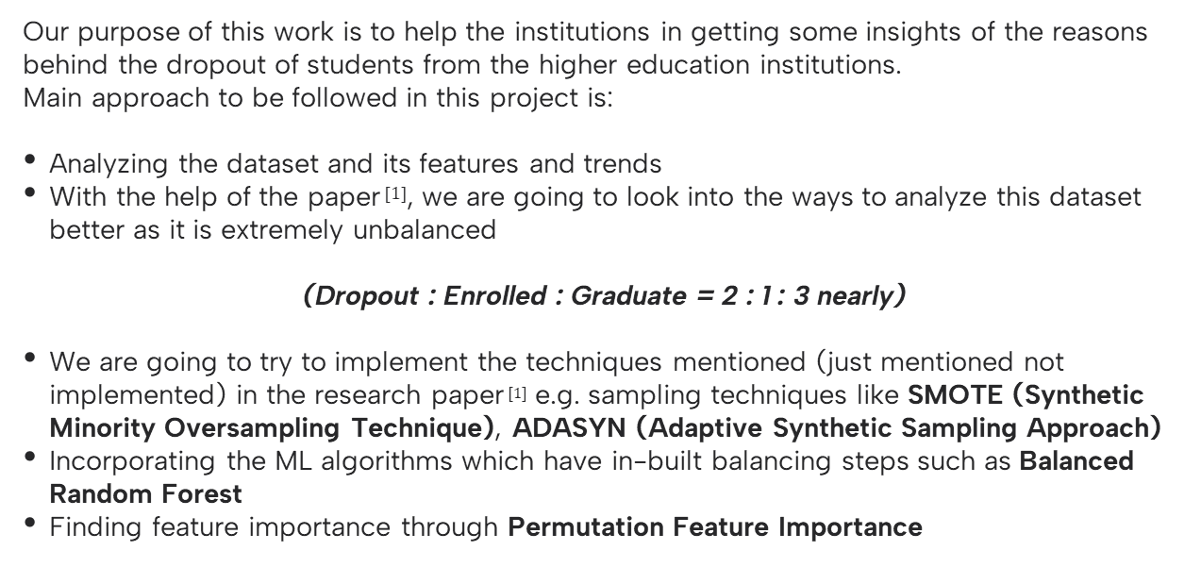
Proposed Methodology
Our purpose of this work is to help the institutions in getting some insights of the reasons behind the dropout of students from the higher education institutions.
Main approach to be followed in this project is:
Analyzing the dataset and its features and trends
With the help of the paper$^{\text{[1]}}$, we are going to look into the ways to analyze this dataset better as it is extremely unbalanced
(Dropout : Enrolled : Graduate = 2 : 1 : 3 nearly)
We are going to try to implement the techniques mentioned (just mentioned not implemented) in the research paper$^{\text{[1]}}$ e.g. sampling techniques like SMOTE (Synthetic Minority Oversampling Technique), ADASYN (Adaptive Synthetic Sampling Approach)
Incorporating the ML algorithms which have in-built balancing steps such as Balanced Random Forest
Finding feature importance through Permutation Feature Importance

Slide 5
Completed till now
We have done the following steps till now:
Data cleaning
Data Transformation
Tried to handle the outliers present in the dataset (could not accomplish)
Visualized the dataset and the relationship between the various features with each other and the target – with count, KDE and heatmap plots
Found out the features that are strongest or most important in the dataset. The technique used to find out the ranking were Correlation and Chi-square test
The most important features are mentioned on the next slide in the rank from strongest to weakest
Deployed various classical ML models like Naïve Bayes, SVM, KNN, Decision Tree, and Random Forest. Also, deployed various newer ML models like AdaBoost, XGBoost, and LogitBoost with 5-fold cross validation.
Analyzed these models and concluded that Random Forest Classifier is the most accurate model with the accuracy of 76% with no overfitting.
Other models were either overfitting or they were less accurate.

Slide 6
Some analytics derived from the dataset
Most of the students with the age of around 23 years are most likely to drop out from the institutions
Students who have pending tuition fees are most likely to drop out. This also infers that their economic condition might not be favorable.
The most important features that have strong correlation with the target feature are:
- Curricular units 2nd sem (grade)
- Curricular units 2nd sem (approved)
- Curricular units 1st sem (approved)
- Curricular units 1st sem (grade)
- Age at enrollment
- Scholarship holder
- Debtor
- Gender
- Tuition fees up to date

Slide 7
Some analytics derived from the dataset (cont.)
When some algorithms like Decision Tree, and KNN were applied on the dataset, they seemed to overfit. They were giving much higher accuracies on the training dataset than on the testing dataset.
There are many outliers in many of the features of the dataset that needs to be handled or removed but we could not do this (searching for some methods to accomplish this)
According to our analysis, we found out that more number of females dropping out were far more than the number of males dropping out.
Dataset is highly imbalanced with respect to the target variable. One of the most important task for next few days would be to remove this misbalancing for more accurate results.

